Slide 1
Learning HTML
1

Slide 2
WHAT IS HTML?
HTML is a language for describing web pages.
HTML stands for Hyper Text Markup Language
HTML is not a programming language, it is a
markup language
A markup language is a set of markup tags
The markup tags describe how text should be
displayed
2

Slide 3
HTML MARKUP TAGS
HTML markup tags are usually called HTML tags
HTML tags are keywords surrounded by angle brackets like <html>
HTML tags normally come in pairs like <b> and
</b>
The first tag in a pair is the start tag, the second tag is the end tag
Note: The start and end tags are also called the opening and closing tags.
3

Slide 4
WHAT IS AN HTML FILE
-An HTML file is a text file with HTML tags
-An HTML file name must end with .htm or .html
-An HTML file can be created using a simple text editor
-An HTML file is often called an HTML document
or a Web Page
4

Slide 5
HTM or HTML EXTENSION
When you save an HTML file, you can use either the .htm or the .html extension. We use .htm in our examples. It is a habit from the past when commonly used software allowed only three letters in file extensions.
With newer software it is perfectly safe to use .html.
5

Slide 6
BASIC HTML TAGS
6

Slide 7
EXAMPLE
<html>
<body>
The content of the body element is displayed in your browser.
</body>
</html>
7

Slide 8
OUTPUT
The content of the body element is displayed in your browser.
8

Slide 9
HTML PARAGRAPHS
<html>
<body>
<p>This is a paragraph.</p>
<p>This is a paragraph.</p>
<p>This is a paragraph.</p>
<p>Paragraph elements are defined by the p tag.</p>
</body>
</html>
9

Slide 10
OUTPUT
This is a paragraph. This is a paragraph. This is a paragraph.
Paragraph elements are defined by the p tag.
10

Slide 11
HTML HEADINGS
Headings are defined with the <h1> to <h6> tags. <h1> defines the largest heading. <h6> defines the smallest heading.
<h1>This is a heading </h1>
<h2>This is a heading </h2>
<h3>This is a heading </h3>
11

Slide 12
Result:
This is a heading This is a heading This is a heading
HTML automatically displays an empty line before and after headings.
12

Slide 13
EXAMPLE
<html>
<body>
<h1>This is heading 1</h1>
<h2>This is heading 2</h2>
<h3>This is heading 3</h3>
<h4>This is heading 4</h4>
<h5>This is heading 5</h5>
<h6>This is heading 6</h6>
<p>Use heading tags only for headings.
Don't use them to make something <b>BIG or BOLD</b>. Use other tags for that.</p>
</body>
</html>
13

Slide 14
OUTPUT
This is heading 1 This is heading 2 This is heading 3 This is heading 4 This is heading 5 This is heading 6
Use heading tags only for headings. Don't use them to make something BIG or BOLD. Use other tags for that.
14

Slide 15
HTML PARAGRAPHS
Paragraphs are defined with the <p> tag.
<p>This is a paragraph</p>
<p>This is another paragraph</p>
HTML automatically displays an empty line before and after a paragraph.
15

Slide 16
EXAMPLE
<html>
<body>
<p>This is a paragraph.</p>
<p>This is a paragraph.</p>
<p>This is a paragraph.</p>
<p>Paragraph elements are defined by the p tag.</p>
</body>
</html>
16

Slide 17
OUTPUT
This is a paragraph.
This is a paragraph. This is a paragraph.
Paragraph elements are defined by the p tag.
17

Slide 18
HTML LINE BREAKS
Use the <br> tag if you want a line break (a new line) without starting a new paragraph:
<p>This is<br>a para<br>graph with line breaks</p>
The <br> tag is an empty tag. It has no end tag like </br>.
18

Slide 19
HTML COMMENTS
Comments can be inserted in the HTML code to make it more readable and understandable.
Comments are ignored by the browser and not
displayed.
Comments are written like this:
<!-- This is a comment -->
Note: There is an exclamation point after the opening bracket, but not before the closing bracket.
19

Slide 20
EXAMPLE
<html>
<body>
<!--This comment will not be displayed-->
<p>This is a regular paragraph</p>
</body>
</html>
20

Slide 21
OUTPUT
This is a regular paragraph
21

Slide 22
EXAMPLE
<html>
<body>
<p>
My Bonnie lies over the ocean. My Bonnie lies over the sea.
My Bonnie lies over the ocean.
Oh, bring back my Bonnie to me.
</p>
<p>Note that your browser ignores your layout!</p>
</body>
</html>
22

Slide 23
OUTPUT
My Bonnie lies over the ocean. My Bonnie lies over the sea. My Bonnie lies over the ocean.
Oh, bring back my Bonnie to me.
Note that your browser ignores your layout!
23

Slide 24
HOW TO VIEW HTML SOURCE
Have you ever seen a Web page and wondered "Hey! How did they do that?“
To find out, click the VIEW option in your browser's toolbar and select SOURCE or PAGE SOURCE. This will open a window that shows you the HTML code of the page.
24

Slide 25
HORIZONTAL RULE
This example demonstrates how to insert a horizontal rule.
<html>
<body>
<p>The hr tag defines a horizontal rule:</p>
<hr>
<p>This is a paragraph</p>
<hr>
<p>This is a paragraph</p>
<hr>
<p>This is a paragraph</p>
</body>
</html>
25

Slide 26
OUTPUT
The hr tag defines a horizontal rule:
This is a paragraph This is a paragraph This is a paragraph
26

Slide 27
Revision
Tag | Description
<html> | Defines an HTML document
<body> | Defines the document's body
<h1> to <h6> | Defines header 1 to header 6
<p> | Defines a paragraph
<br> | Inserts a single line break
<hr> | Defines a horizontal rule
<!--> | Defines a comment
27

Slide 28
HTML ELEMENT
An HTML Element
Start | Element | ContentEnd
<p> | This is a paragraph | </p>
28

Slide 29
WHY LOWERCASE TAGS?
HTML tags are not case sensitive:
<P> means the same as <p>.
Plenty of web sites use uppercase HTML tags in their pages.
Recommends lowercase in HTML 4, and demands lowercase tags in newer versions of (X)HTML.
29

Slide 30
HTML ATTRIBUTES
Attributes provide additional information about HTML elements.
30

Slide 31
HTML ATTRIBUTES
HTML tags can have attributes. Attributes provide additional information about the HTML element.
Attributes always come in name/value pairs like this: name="value“.
Attributes are always specified in the start tag of an HTML element.
31

Slide 32
ATTRIBUTES EXAMPLE-1
<body> defines the body of an HTML document.
<body bgcolor="yellow"> has additional information about the background color.
32

Slide 33
CENTER ALIGNED HEADING
<html>
<body>
<h1 align="center">This is heading 1</h1>
<p>The heading above is aligned to the center of this page. The heading above is aligned to the center of this page. The heading above is aligned to the center of this page.</p>
</body>
</html>
33

Slide 34
OUTPUT
This is heading 1
The heading above is aligned to the center of this page. The heading above is aligned to the center of this page. The heading above is aligned to the center of this page.
34

Slide 35
ATTRIBUTES EXAMPLE- 2
<body> defines the body of an HTML document.
<body bgcolor="yellow"> has additional information about the background color.
35

Slide 36
EXAMPLE: BACKGROUND COLOR
<html>
<body bgcolor="yellow">
<h2>Look: Colored Background!</h2>
</body>
</html>
36

Slide 37
OUTPUT
LOOK: COLORED BACKGROUND!
37

Slide 38
ATTRIBUTES EXAMPLE- 3
<table> defines an HTML table.
<table border="1"> has additional information about the border around the table.
38

Slide 39
HTML TEXT FORMATTING
This text is bold
This text is big
This text is italic
This is computer output
This is and superscript subscript
39

Slide 40
EXAMPLE
<html>
<body>
<p><b>This text is bold</b></p>
<p><big>This text is big</big></p>
<p><i>This text is italic</i></p>
<p><code>This is computer output</code></p>
<p>This is<sub> subscript</sub> and
<sup>superscript</sup></p>
</body>
</html>
40

Slide 41
HTML FORMATTING TAGS
HTML uses tags like <b> and <i> for formatting output, like bold or italic text.
These HTML tags are called formatting tags.
41

Slide 42
EXAMPLE - TEXT FORMATTING
<html>
<body>
<p><b>This text is bold</b></p>
<p><strong>This text is strong</strong></p>
<p><big>This text is big</big></p>
<p><em>This text is emphasized</em></p>
<p><i>This text is italic</i></p>
<p><small>This text is small</small></p>
<p>This is<sub> subscript</sub> and <sup>superscript</sup></p>
</body>
</html>
42

Slide 43
OUTPUT
This text is bold
This text is strong
This text is big
This text is emphasized This text is italic
This text is small
This is
and superscript
subscript
43

Slide 44
EXAMPLE – PREFORMATTED TEXT
<html>
<body>
<pre>
This is preformatted text.
It preserves both spaces and line breaks.
</pre>
<p>The pre tag is good for displaying computer code:</p>
<pre>
for i = 1 to 10 print i
next i
</pre>
</body>
</html>
44

Slide 45
OUTPUT
This is preformatted text. It preserves both spaces and line breaks.
The pre tag is good for displaying computer code:
for i = 1 to 10
print i
next i
45

Slide 46
ADDRESS
<html>
<body>
<address> Donald Duck<br> BOX 555<br>
Disneyland<br> USA
</address>
</body>
</html>
46

Slide 47
OUTPUT
Donald Duck BOX 555
Disneyland USA
47

Slide 48
ABBREVIATIONS AND ACRONYMS
<html>
<body>
<abbr title="United Nations">UN</abbr>
<br>
<acronym title="World Wide Web">WWW</acronym>
<p>The title attribute is used to show the spelled-out version when holding the mouse pointer over the acronym or abbreviation.</p>
<p>This only works for the acronym element in IE 5.</p>
<p>This works for both the abbr and acronym element in Netscape 6.2.</p>
</body>
</html>
48

Slide 49
OUTPUT
UN WWW
The title attribute is used to show the spelled-out version when holding the mouse pointer over the acronym or abbreviation.
This only works for the acronym element in IE 5.
This works for both the abbr and acronym element in Netscape 6.2.
49

Slide 50
EXAMPLE – QUOTATIONS
<html>
<body>
Here comes a long quotation:
<blockquote>
This is a long quotation. This is a long quotation. This is a long quotation. This is a long quotation. This is a long quotation.
</blockquote>
Here comes a short quotation:
<q>
This is a short quotation
</q>
<p>
With the block quote element, the browser inserts line breaks and margins, but the q element does not render as anything special.
</p>
</body>
</html>
50

Slide 51
OUTPUT
Here comes a long quotation:
This is a long quotation. This is a long quotation. This is a long quotation. This is a long quotation. This is a long quotation.
Here comes a short quotation: This is a short quotation
With the block quote element, the browser inserts line breaks and margins, but the q element does not render as anything special.
51

Slide 52
DELETED AND INSERTED TEXT
<html>
<body>
<p>
a dozen is
<del>twenty</del>
<ins>twelve</ins> pieces
</p>
<p>
Most browsers will overstrike deleted text and underline inserted text.
</p>
<p>
Some older browsers will display deleted or inserted text as plain text.
</p>
</body>
</html>
52

Slide 53
OUTPUT
a dozen is twenty twelve pieces
Most browsers will overstrike deleted text and underline inserted text.
Some older browsers will display deleted or inserted text as plain text.
53

Slide 54
Revision
Tag | Description
<b> | Defines bold text
<big> | Defines big text
<em> | Defines emphasized text
<i> | Defines italic text
<small> | Defines small text
<strong> | Defines strong text
54

Slide 55
Tag | Description
<sub> | Defines subscripted text
<sup> | Defines superscripted text
<ins> | Defines inserted text
<del> | Defines deleted text
<s> | Deprecated. Use <del> instead
<strike> | Deprecated. Use <del> instead
<u> | Deprecated. Use styles instead 5
5

Slide 56
NON-BREAKING SPACE
The most common character entity in HTML is the non-breaking space.
Normally HTML will truncate spaces in your text. If you write 10 spaces in your text HTML will remove 9 of them.
To add lots of spaces to your text, use the &nbsp; character entity.
56

Slide 57
COMMONLY USED CHARACTER
Result | Description | Entity Name | Entity Number
 | non-breaking space | &nbsp; | &#160;
< | less than | &lt; | &#60;
> | greater than | &gt; | &#62;
& | ampersand | &amp; | &#38;
¢ | cent | &cent; | &#162; 57

Slide 58
Result | Description | Entity Name | Entity Number
£ | pound | &pound; | &#163;
¥ | yen | &yen | &#165;
€ | euro | &euro; | &#8364;
§ | section | &sect; | &#167;
© | copyright | &copy; | &#169;
® | registered trademark | &reg; | &#174;
58

Slide 59
HTML LINKS
HTML uses a hyperlink to link to another document on the Web.
59

Slide 60
EXAMPLES
Create hyperlinks
This example demonstrates how to create links in an HTML document.
An image as a link
This example demonstrates how to use an image as a link.
60

Slide 61
EXAMPLE - CREATE HYPERLINKS
<html>
<body>
<p>
<a href="lastpage.htm">
This text</a> is a link to a page on this Web site.
</p>
<p>
<a href="http://www.microsoft.com/">
This text</a> is a link to a page on the World Wide Web.
</p>
</body>
</html>
61

Slide 62
OUTPUT
This text is a link to a page on this Web site.
This text is a link to a page on the World Wide Web.
62

Slide 63
AN IMAGE AS A LINK
<html>
<body>
<p>
You can also use an image as a link:
<a href="lastpage.htm">
<img border="0" src="buttonnext.gif" width="65" height="38">
</a>
</p>
</body>
</html>
63

Slide 64

OUTPUT
You can also use an image as a link:
64

Slide 65
THE ANCHOR TAG AND THE href ATTRIBUTE
HTML uses the <a> (anchor) tag to create a link to another document.
An anchor can point to any resource on the Web: an HTML page, an image, a sound file, a movie, etc.
The syntax of creating an anchor:
65

Slide 66
THE ANCHOR TAG AND THE Href ATTRIBUTE
<a href="url">Text to be displayed</a>
The <a> tag is used to create an anchor to link from, the href attribute is used to address the document to link to, and the words between the open and close of the anchor tag will be displayed as a hyperlink.
66

Slide 67
THE TARGET ATTRIBUTE
With the target attribute, you can define where the linked document will be opened. The line below will open the document in a new browser window:
<a href= “www.staloysiuscollege.ac.in” target="_blank">Visit St.Aloysius College.</a>
67

Slide 68
The Anchor Tag and the Name Attribute
The name attribute is used to create a named anchor. When using named anchors we can create
links that can jump directly into a specific section on a page, instead of letting the user scroll around to find what he/she is looking for.
Below is the syntax of a named anchor:
<a name="label">Text to be displayed</a>
68

Slide 69
OPEN A LINK IN A NEW BROWSER WINDOW
<html>
<body>
<a href="lastpage.htm" target="_blank">Last Page</a>
<p>
If you set the target attribute of a link to "_blank", the link will open in a new window.
</p>
</body>
</html>
69

Slide 70
OUTPUT
Last Page
If you set the target attribute of a link to "_blank", the link will open in a new window.
70

Slide 71
LINK TO A LOCATION ON THE SAME PAGE
<html>
<body>
<p>
<a href="#C4">See also Chapter 4.</a>
</p>
<h2>Chapter 1</h2>
<p>This chapter explains ba bla bla</p>
<h2>Chapter 2</h2>
<p>This chapter explains ba bla bla</p>
<h2>Chapter 3</h2>
<p>This chapter explains ba bla bla</p>
</body>
</html>
71

Slide 72
OUTPUT
See also Chapter 4.
Chapter 1
This chapter explains ba bla bla
Chapter 2
This chapter explains ba bla bla
Chapter 3
This chapter explains ba bla bla
72

Slide 73
CREATE A MAILTO LINK
<html>
<body>
<p>
This is a mail link:
<a href="mailto:someone@microsoft.com?subject=Hello%20again"> Send Mail</a>
</p>
<p>
<b>Note:</b> Spaces between words should be replaced by %20 to
<b>ensure</b> that the browser will display your text properly.
</p>
</body>
</html>
73

Slide 74
OUTPUT
This is a mail link: Send Mail
Note: Spaces between words should be replaced by %20 to ensure that the browser will display your text properly.
74

Slide 75
HTML FRAMES
With frames, you can display more than one Web page in the same browser window.
75

Slide 76
VERTICAL FRAMESET
<html>
<frameset cols="25%,50%,25%">
<frame src="frame_a.htm">
<frame src="frame_b.htm">
<frame src="frame_c.htm">
</frameset>
</html>
76

Slide 77
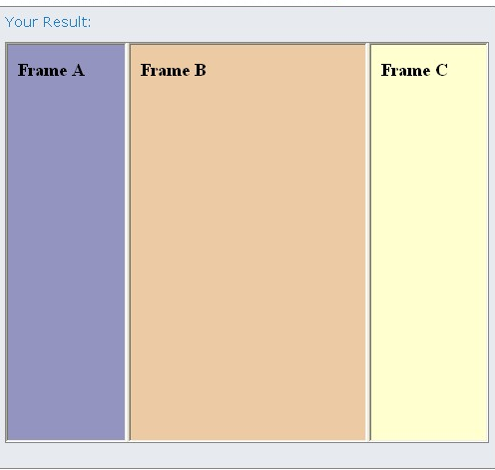
OUTPUT
77

Slide 78
HORIZONTAL FRAMESET
<html>
<frameset rows="25%,50%,25%">
<frame src="frame_a.htm">
<frame src="frame_b.htm">‘
<frame src="frame_c.htm">
</frameset>
</html>
78

Slide 79
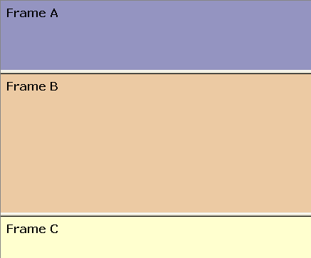
OUTPUT
79

Slide 80
FRAMES
With frames, you can display more than one HTML document in the same browser window. Each HTML document is called a frame, and each frame is independent of the others.
The disadvantages of using frames are:
The web developer must keep track of more HTML documents
It is difficult to print the entire page
80

Slide 81
THE FRAMESET TAG
The <frameset> tag defines how to divide the window into frames.
Each frameset defines a set of rows or
Columns.
The values of the rows/columns indicate the amount of screen area each row/column will occupy.
81

Slide 82
THE FRAME TAG
The <frame> tag defines what HTML document to put into each frame.
In the example below we have a frameset with two columns.
The first column is set to 25% of the width of the browser window. The second column is set to 75% of the width of the browser window. The HTML document "frame_a.htm" is put into the first column, and the HTML document "frame_b.htm" is put into the second column:
82

Slide 83
THE FRAME TAG
<frameset cols="25%,75%">
<frame src="frame_a.htm">
<frame src="frame_b.htm">
</frameset>
Note: The frameset column size value can also be
set in pixels (cols="200,500"), and one of the columns can be set to use the remaining space (cols="25%,*").
83

Slide 84
BASIC NOTES - USEFUL TIPS
If a frame has visible borders, the user can resize it by dragging the border. To prevent a user from doing this, you can add noresize="noresize" to the
<frame> tag.
Add the <noframes> tag for browsers that do not support frames.
Important: You cannot use the <body></body> tags together with the <frameset></frameset> tags! However, if you add a <noframes> tag containing some text for browsers that do not support frames, you will have to enclose the text in <body></body> tags! See how it is done in the first example below.
84

Slide 85
HOW TO USE THE <NOFRAMES> TAG
<html>
<frameset cols="25%,50%,25%">
<frame src="frame_a.htm">
<frame src="frame_b.htm">
<frame src="frame_c.htm">
<noframes>
<body>Your browser does not handle frames!</body>
</noframes>
</frameset>
</html>
85

Slide 86
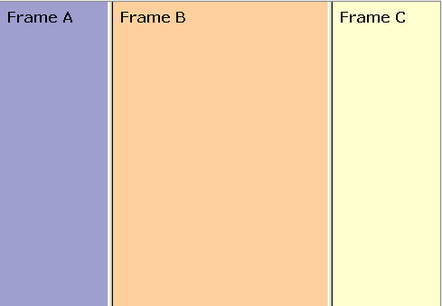
OUTPUT
86

Slide 87
MIXED FRAMESET
<html>
<frameset rows="50%,50%">
<frame src="frame_a.htm">
<frameset cols="25%,75%">
<frame src="frame_b.htm">
<frame src="frame_c.htm">
</frameset>
</frameset>
</html>
87

Slide 88
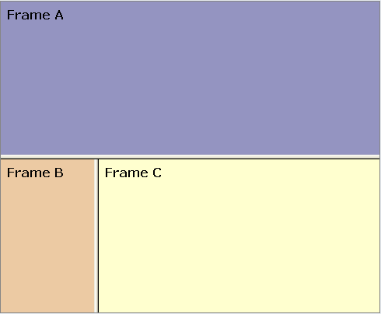
OUTPUT
88

Slide 89
FRAMESET WITH NORESIZE=“NORESIZE’
<html>
<frameset rows="50%,50%">
<frame noresize="noresize" src="frame_a.htm">
<frameset cols="25%,75%">
<frame noresize="noresize" src="frame_b.htm">
<frame noresize="noresize" src="frame_c.htm">
</frameset>
</frameset>
</html>
89

Slide 90
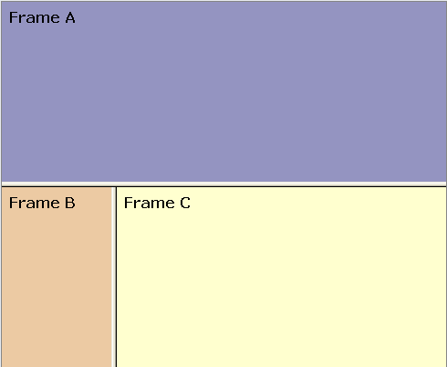
OUTPUT
90

Slide 91
NAVIGATION FRAME
<html>
<frameset cols="120,*">
<frame src="tryhtml_contents.htm">
<frame src="frame_a.htm" name="showframe">
</frameset>
</html>
91

Slide 92
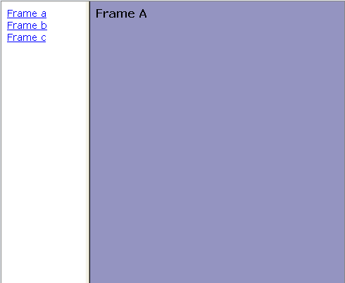
OUTPUT
92

Slide 93
JUMP TO A SPECIFIED SECTION WITHIN A FRAME
<html>
<frameset cols="20%,80%">
<frame src="frame_a.htm">
<frame src="link.htm#C10">
</frameset>
</html>
93

Slide 94
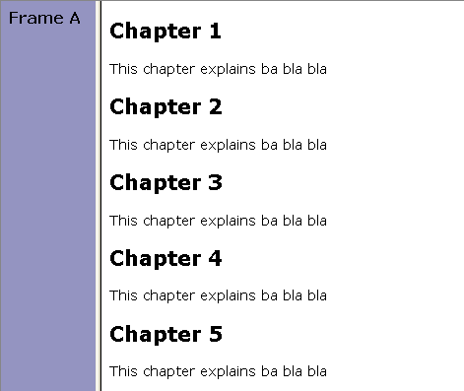
OUTPUT
94

Slide 95
JUMP TO A SPECIFIED SECTION WITH FRAME NAVIGATION
<html>
<frameset cols="180,*">
<frame src="content.htm">
<frame src="link.htm" name="showframe">
</frameset>
</html>
95

Slide 96
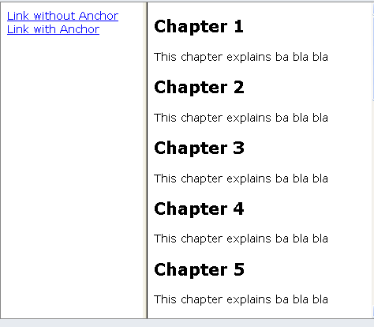
OUTPUT
96

Slide 97
FRAME TAGS
Tag | Description
<frameset> | Defines a set of frames
<frame>) | Defines a sub window (a frame
<noframes> | Defines a noframe section for browsers that do not handle frames
97

Slide 98
HTML TABLES
With HTML you can create tables.
Examples
Tables
This example demonstrates how to create tables in an HTML document. Table borders
This example demonstrates different table borders. (You can find more examples at the bottom of this page)
98

Slide 99
EXAMPLE: TABLES
<html>
<body>
<p>
Each table starts with a table tag. Each table row starts with a tr tag.
Each table data starts with a td tag.
</p>
<h4>One column:</h4>
<table border="1">
<tr>
<td>100</td>
</tr>
</table>
<h4>One row and three columns:</h4>
<table border="1">
<tr>
<td>100</td>
<td>200</td>
99

Slide 100
EXAMPLE:TABLES
<td>300</td>
</tr>
</table>
<h4>Two rows and three columns:</h4>
<table border="1">
<tr>
<td>100</td>
<td>200</td>
<td>300</td>
</tr>
<tr>
<td>400</td>
<td>500</td>
<td>600</td>
</tr>
</table>
</body>
</html>

Slide 101
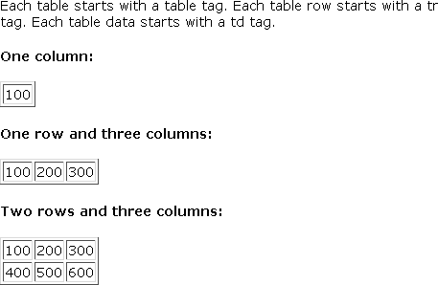
OUTPUT

Slide 102
TABLE BORDERS
<html>
<body>
<h4>With a normal border:</h4>
<table border="1">
<tr>
<td>First</td>
<td>Row</td>
</tr>
<tr>
<td>Second</td>
<td>Row</td>
</tr>
</table>
<h4>With a thick border:</h4>
<table border="8">

Slide 103
TABLE BORDERS
<tr>
<td>First</td>
<td>Row</td>
</tr>
<tr>
<td>Second</td>
<td>Row</td>
</tr>
</table>
<h4>With a very thick border:</h4>
<table border="15">
<tr>
<td>First</td>
<td>Row</td>
</tr>
<tr>
<td>Second</td>
<td>Row</td>
</tr>
</table>
</body>
</html>

Slide 104
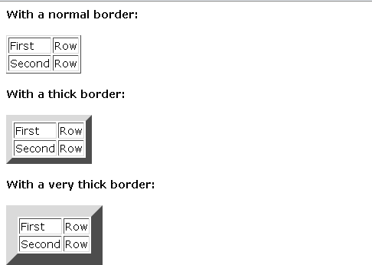
OUTPUT

Slide 105
TABLES
Tables are defined with the <table> tag. A table is divided into rows (with the <tr> tag), and each row is divided into data cells (with the <td> tag). The letters td stands for "table data," which is the content of a data cell. A data cell can contain text, images, lists, paragraphs, forms, horizontal rules, tables, etc.

Slide 106
TABLES
<table border="1">
<tr>
<td>row 1, cell 1</td>
<td>row 1, cell 2</td>
</tr>
<tr>
<td>row 2, cell 1</td>
<td>row 2, cell 2</td>
</tr>
</table>

Slide 107

TABLES
How it looks in a browser:

Slide 108
TABLES AND THE BORDER ATTRIBUTE
If you do not specify a border attribute the table will be displayed without any borders. Sometimes this can be useful, but most of the time, you want the borders to show. To display a table with borders, you will have to use the border attribute:
<table border="1">
<tr>
<td>Row 1, cell 1
</td>
<td>Row 1, cell 2</td>
</tr>
</table>

Slide 109
HEADINGS IN A TABLE
Headings in a table are defined with the
<th> tag.
<table border="1">
<tr>
<th>Heading
</th>
<th>Another Heading </th>
</tr>
<tr>
<td>row 1, cell 1
</td>
<td>row 1, cell 2 </td>
</tr>
<tr>
<td>row 2, cell 1</td>
<td>row 2, cell 2</td>
</tr>
</table>

Slide 110

HEADINGS IN A TABLE
How it looks in a browser:

Slide 111
TABLE WITH NO BORDER
This example demonstrates a table with no borders.
<html>
<body>
<h4>This table has no borders:</h4>
<table>
<tr>
<td>100</td>
<td>200</td>
<td>300</td>
</tr>
<tr>
<td>400</td>
<td>500</td>
<td>600</td>
</tr>
</table>

Slide 112
TABLE WITH NO BORDER
<h4>And this table has no borders:</h4>
<table border="0">
<tr>
<td>100</td>
<td>200</td>
<td>300</td>
</tr>
<tr>
<td>400</td>
<td>500</td>
<td>600</td>
</tr>
</table>
</body>
</html>

Slide 113
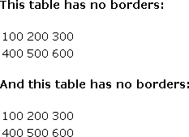
OUTPUT

Slide 114
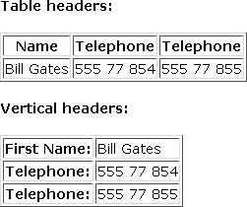
To do….

Slide 115
TABLE WITH CAPTION
This example demonstrates a table with a caption.
<html>
<body>
<h4>
This table has a caption, and a thick border:
</h4>
<table border="6">
<caption>My Caption</caption>
<tr>
<td>100</td>
<td>200</td>
<td>300</td>
</tr>
<tr>
<td>400</td
<td>500</td>
<td>600</td>
</tr>
</table>
</body>
</html>

Slide 116
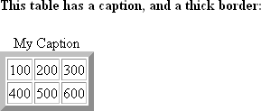
OUTPUT

Slide 117
TABLE CELLS THAT SPAN MORE THAN ONE ROW/COLUMN
This example demonstrates how to define table cells that span more than one row or one column.
<html>
<body>
<h4>Cell that spans two columns:</h4>
<table border="1">
<tr>
<th>Name</th>
<th colspan="2">Telephone</th>
</tr>
<tr>
<td>Bill Gates</td>
<td>555 77 854</td>
<td>555 77 855</td>
</tr>
</table>
`

Slide 118
TABLE CELLS THAT SPAN MORE THAN ONE ROW/COLUMN
<h4>Cell that spans two rows:</h4>
<table border="1">
<tr>
<th>First Name:</th>
<td>Bill Gates</td>
</tr>
<tr>
<th rowspan="2">Telephone:</th>
<td>555 77 854</td>
</tr>
<tr>
<td>555 77 855</td>
</tr>
</table>
</body>
</html>
118

Slide 119
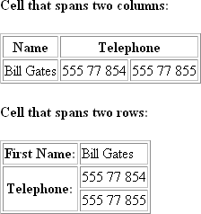
OUTPUT

Slide 120
CELL PADDING
This example demonstrates how to use cell padding to create more white space between the cell content and its borders.
<html>
<body>
<h4>Without cellpadding:</h4>
<table border="1">
<tr>
<td>First</td>
<td>Row</td>
</tr>
<tr>
<td>Second</td>
<td>Row</td>
</tr>
</table>

Slide 121
EXAMPLE: CELL PADDING
<h4>With cellpadding:</h4>
<table border="1" cellpadding="10">
<tr>
<td>First</td>
<td>Row</td>
</tr>
<tr>
<td>Second</td>
<td>Row</td>
</tr>
</table>
</body>
</html>

Slide 122
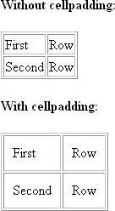
OUTPUT

Slide 123
EXAMPLE: CELL SPACING
This example demonstrates how to use cellspacing to increase the distance between the cells.
<html>
<body>
<h4>Without cellspacing:</h4>
<table border="1">
<tr>
<td>First</td>
<td>Row</td>
</tr>
<tr>
<td>Second</td>
<td>Row</td>
</tr>
</table>

Slide 124
EXAMPLE: CELL SPACING
<h4>With cellspacing:</h4>
<table border="1" cellspacing="10">
<tr>
<td>First</td>
<td>Row</td>
</tr>
<tr>
<td>Second</td>
<td>Row</td>
</tr>
</table>
</body>
</html>

Slide 125
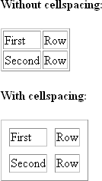
OUTPUT

Slide 126
ADD A BACKGROUND COLOR OR A BACKGROUND IMAGE TO A TABLE
This example demonstrates how to add a background to a table.
<html>
<body>
<h4>A background color:</h4>
<table border="1" bgcolor="red">
<tr>
<td>First</td>
<td>Row</td>
</tr>
<tr>
<td>Second</td>
<td>Row</td>
</tr>
</table>

Slide 127
ADD A BACKGROUND COLOR OR A BACKGROUND IMAGE TO A TABLE
<h4>A background image:</h4>
<table border="1" background="bgdesert.jpg">
<tr>
<td>First</td>
<td>Row</td>
</tr>
<tr>
<td>Second</td>
<td>Row</td>
</tr>
</table>
</body>
</html>

Slide 128
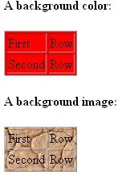
OUTPUT

Slide 129
ADD A BACKGROUND COLOR OR A BACKGROUND IMAGE TO A TABLE CELL
This example demonstrates how to add a background to one or more table cells.
<html>
<body>
<h4>Cell backgrounds:</h4>
<table border="1">
<tr>
<td bgcolor="red">First</td>
<td>Row</td>
</tr>
<tr>
<td background="bgdesert.jpg"> Second</td>
<td>Row</td>
</tr>
</table>
</body>
</html>

Slide 130
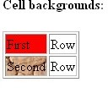
OUTPUT

Slide 131
ALIGN THE CONTENT IN A TABLE CELL
This example demonstrates how to use the "align" attribute to align the content of cells, to create a "nice-looking" table.
<html>
<body>
<table width="400" border="1">
<tr>
<th align="left">Money spent on....</th>
<th align="right">January</th>
<th align="right">February</th>
</tr>
<tr>
<td align="left">Clothes</td>
<td align="right">$241.10</td>
<td align="right">$50.20</td>
</tr>

Slide 132
ALIGN THE CONTENT IN A TABLE CELL
<tr>
<td align="left">Make-Up</td>
<td align="right">$30.00</td>
<td align="right">$44.45</td>
</tr>
<tr>
<td align="left">Food</td>
<td align="right">$730.40</td>
<td align="right">$650.00</td>
</tr>
<tr>
<th align="left">Sum</th>
<th align="right">$1001.50</th>
<th align="right">$744.65</th>
</tr>
</table>
</body>
</html>

Slide 133
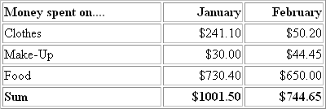
To Do..

Slide 134
HTML LIST
HTML supports
An unordered list An ordered list An defination list

Slide 135
AN UNORDERED LIST
<html>
<body>
<h4>An Unordered List:</h4>
<ul>
<li>Coffee</li>
<li>Tea</li>
<li>Milk</li>
</ul>
</body>
</html>

Slide 136
OUTPUT
An Unordered List:
Coffee
Tea
Milk

Slide 137
AN ORDERED LIST
<html>
<body>
<h4>An Ordered List:</h4>
<ol>
<li>Coffee</li>
<li>Tea</li>
<li>Milk</li>
</ol>
</body>
</html>

Slide 138
OUTPUT
An Ordered List:
1.Coffee 2.Tea
3. Milk

Slide 139
DEFINITION LISTS
A definition list is not a list of items. This is a list of terms and explanation of the terms.
A definition list starts with the <dl> tag. Each definition-list term starts with the <dt> tag.
Each definition-list definition starts with the <dd> tag.
<dl>
<dt>Coffee</dt>
<dd>Black hot drink</dd>
<dt>Milk</dt>
<dd>White cold drink</dd>
</dl>

Slide 140
DEFINITION LISTS
Here is how it looks in a browser:
Coffee
Black hot drink
Milk
White cold drink

Slide 141
DIFFERENT TYPES OF ORDERED LISTS
This example demonstrates different types of ordered lists.
<html>
<body>
<h4>Numbered list:</h4>
<ol>
<li>Apples</li>
<li>Bananas</li>
<li>Lemons</li>
<li>Oranges</li>
</ol>

Slide 142
OUTPUT
Numbered list:
1. Apples 2.Bananas 3.Lemons 4.Oranges

Slide 143
DIFFERENT TYPES OF ORDERED LISTS
<h4>Letters list:</h4>
<ol type="A">
<li>Apples</li>
<li>Bananas</li>
<li>Lemons</li>
<li>Oranges</li>
</ol>

Slide 144
OUTPUT
Letters list:
Apples
Bananas
Lemons
Oranges

Slide 145
DIFFERENT TYPES OF ORDERED LISTS
<h4>Lowercase letters list:</h4>
<ol type="a">
<li>Apples</li>
<li>Bananas</li>
<li>Lemons</li>
<li>Oranges</li>
</ol>

Slide 146
OUTPUT
Lowercase letters list:
Apples
Bananas
Lemons
c. Oranges

Slide 147
DIFFERENT TYPES OF ORDERED LISTS
<h4>Roman numbers list:</h4>
<ol type="I">
<li>Apples</li>
<li>Bananas</li>
<li>Lemons</li>
<li>Oranges</li>
</ol>

Slide 148
OUTPUT
Roman numbers list:
Apples
Bananas
Lemons
Oranges

Slide 149
DIFFERENT TYPES OF ORDERED LISTS
<h4>Lowercase Roman numbers list:</h4>
<ol type="i">
<li>Apples</li>
<li>Bananas</li>
<li>Lemons</li>
<li>Oranges</li>
</ol>
</body>
</html>

Slide 150
OUTPUT
Lowercase Roman numbers list:
Apples
Bananas
Lemons
Oranges

Slide 151
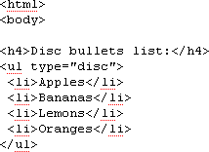
DIFFERENT TYPES OF UNORDERED LISTS
This example demonstrates different types of unordered lists.

Slide 152
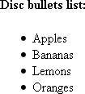
OUTPUT

Slide 153
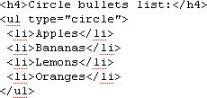
DIFFERENT TYPES OF UNORDERED LISTS

Slide 154
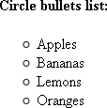
OUTPUT

Slide 155
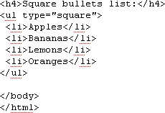
DIFFERENT TYPES OF UNORDERED LISTS

Slide 156
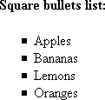
OUTPUT

Slide 157
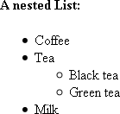
To do..

Slide 158
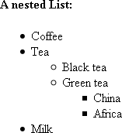
To do…

Slide 159
Revision
Tag | Description
<ol> | Defines an ordered list
<ul> | Defines an unordered list
<li> | Defines a list item
<dl> | Defines a definition list

Slide 160
LIST TAGS
Tag | Description
<dt> | Defines a definition term
<dd> | Defines a definition description

Slide 161
HTML FORMS AND INPUT
HTML Forms are used to select different kinds of user input.
Examples
Text fields
This example demonstrates how to create text fields on an HTML page. A user can write text in a text field.
Password fields
This example demonstrates how to create a password field on an HTML page.

Slide 162
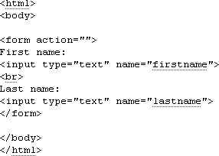
EXAMPLE: TEXT FIELDS

Slide 163

OUTPUT

Slide 164
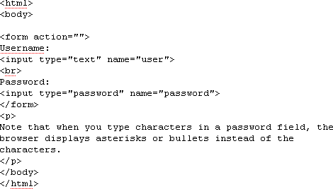
PASSWORD FIELDS

Slide 165

OUTPUT

Slide 166
FORMS
A form is an area that can contain form elements.
Form elements are elements that allow the user to enter information (like text fields, textarea fields, drop-down menus, radio buttons, checkboxes, etc.) in a form.
A form is defined with the <form> tag.
<form>
<input>
</input>
</form>

Slide 167
INPUT
The most used form tag is the <input> tag. The type of input is specified with the type attribute. The most commonly used input types are explained below.

Slide 168
TEXT FIELDS
Text fields are used when you want the user to type letters, numbers, etc. in a form.
<form> First name:
<input type="text" name="firstname">
<br>
Last name:
<input type="text" name="lastname">
</form>

Slide 169

TEXT FIELDS
How it looks in a browser:
First name:
Last name:
Note that the form itself is not visible. Also note that in most browsers, the width of the text field is 20 characters by default.

Slide 170
RADIO BUTTONS
Radio Buttons are used when you want the user to select one of a limited number of choices.
<form>
<input type="radio" name="sex" value="male"> Male
<br>
<input type="radio" name="sex" value="female">Female
</form>

Slide 171
RADIO BUTTONS
How it looks in a browser:
Male Female
Note that only one option can be chosen.

Slide 172
CHECKBOXES
Checkboxes are used when you want the user to select one or more options of a limited number of choices.
<form>
I have a bike:
<input type="checkbox" name="vehicle" value="Bike">
<br>
I have a car:
<input type="checkbox" name="vehicle" value="Car">
<br>
I have an airplane:
<input type="checkbox" name="vehicle" value="Airplane">
</form>

Slide 173

CHECKBOXES

Slide 174
THE FORM’S ACTION ATTRIBUT AND THE SUBMIT BUTTON
When the user clicks on the "Submit" button, the content of the form is sent to the server. The form's action attribute defines the name of the file to send the content to. The file defined in the action attribute usually does something with the received input.
<form name="input" action="html_form_submit.asp" method="get">
Username:
<input type="text" name="user">
<input type="submit" value="Submit">
</form>

Slide 175
THE FORM’S ACTION ATTRIBUT AND THE SUBMIT BUTTON
How it looks in a browser:
Username:
If you type some characters in the text field above, and click the "Submit" button, the browser will send your input to a page called "html_form_submit.asp". The page will show you the received input.

Slide 176
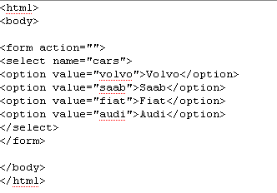
SIMPLE DROP DOWN BOX
This example demonstrates how to create a simple drop-down box on
an HTML page. A drop-down box is a selectable list.

Slide 177
OUTPUT

Slide 178
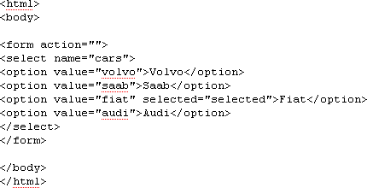
ANOTHER DROP DOWN BOX
This example demonstrates how to create a simple drop- down box with a pre-selected value.

Slide 179
OUTPUT

Slide 180
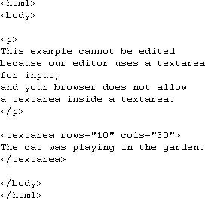
EXAMPLE: TEXTAREA
This example demonstrates how to create a text-area (a multi-line text input control). A user can write text in the text-area. In a text-area you can write an unlimited number of characters.

Slide 181
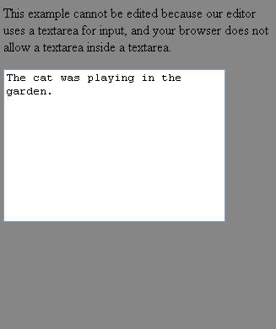
OUTPUT

Slide 182
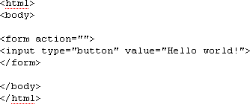
CREAT A BUTTON
This example demonstrates how to create a button. On the button you can define your own text.

Slide 183
OUTPUT

Slide 184
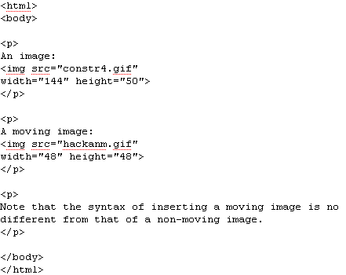
EXAMPLE: INSERT IMAGES

Slide 185
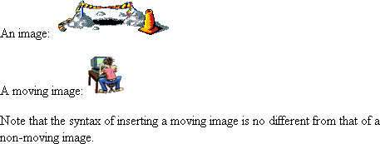
OUTPUT

Slide 186
THE ALT ATTRIBUTE
The alt attribute is used to define an "alternate text" for an image. The value of the alt attribute is an author-defined text:
<img src="boat.gif" alt="Big Boat">
The "alt" attribute tells the reader what he or she is missing on a page if the browser can't load images. The browser will then display the alternate text instead of the image. It is a good practice to include the "alt" attribute for each image on a page, to improve the display and usefulness of your document for people who have text-only browsers.

Slide 187
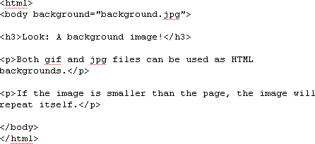
BACKGROUND MAGE
This example demonstrates how to add a background image to an HTML page.

Slide 188
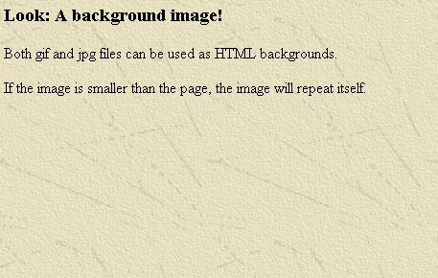
OUTPUT

Slide 189
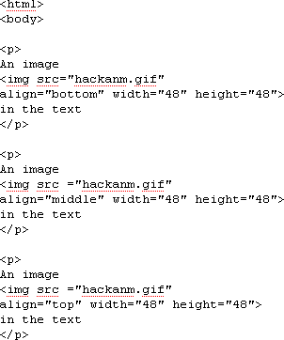
ALIGNING IMAGES
This example demonstrates how to align an image within the text.

Slide 190
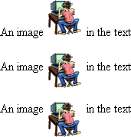
OUTPUT

Slide 191
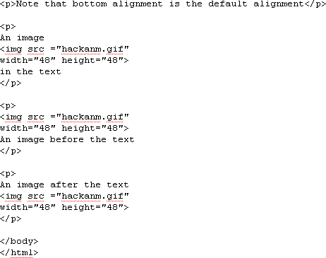
ALIGNING IMAGES

Slide 192
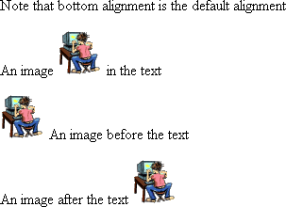
OUTPUT

Slide 193
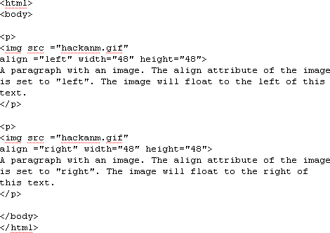
LET THE IMAGE FLOAT
This example demonstrates how to let an image float to the left or right of a paragraph.

Slide 194
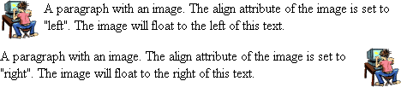
OUTPUT

Slide 195
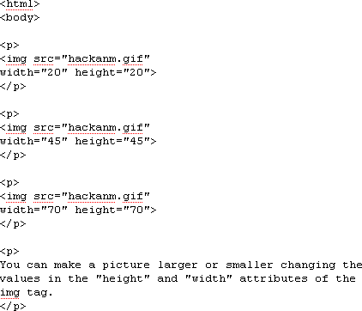
ADJUST IMAGE TO DIFFERENT SIZES
This example demonstrates how to adjust images to different sizes.

Slide 196
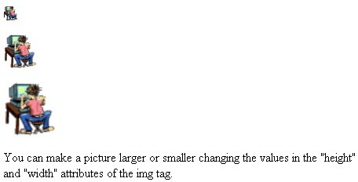
OUTPUT

Slide 197
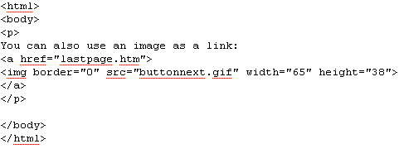
MAKE A HYPERLINK OF AN IMAGE
This example demonstrates how to use an image as a link.

Slide 198

OUTPUT

Slide 199
HTML META
Document description
Information inside a meta element describes the document.
Document keywords
Information inside a meta element describes the document's keywords.
Redirect a user
This example demonstrates how to redirect a user if your site address has changed.

Slide 200
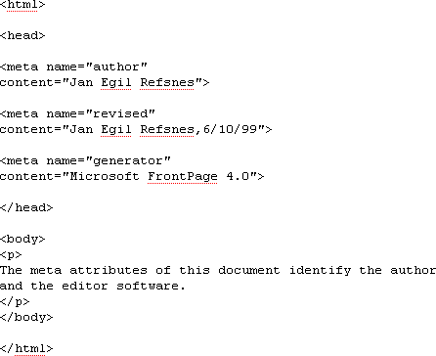
DOCUMENT DESCRIPTION

Slide 201
OUTPUT

Slide 202
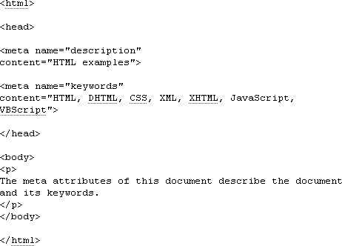
DOCUMENT KEYWORDS

Slide 203
OUTPUT

Slide 204
KEYWORDS FOR SEARCH ENGINES
Some search engines on the WWW will use the name and content attributes of the meta tag to index your pages.
This meta element defines a description of your page:
<meta name="description" content="Free Web tutorials on HTML, CSS, XML, and XHTML">
This meta element defines keywords for your page:
<meta name="keywords" content="HTML, DHTML, CSS, XML, XHTML, JavaScript, VBScript">

Slide 205
Thank you

